Slide 1
ME 162 BASIC MECHANICS
Course Lecturer: Dr. Joshua Ampofo
Email: josh.ampofo@gmail.com/auspi@hotmail.com

Slide 2
Course Content
Fundamental Concept
  Newton’s Laws of Motion
  Force Systems and Characteristics of Forces & Moments
  Vector Representation of Forces and Moments
Basic Statics
  Equilibrium of Rigid Bodies in 2D and 3D
Structural Analysis
  Methods of Joints
  Method of Sections
Friction
Simple Machines
Basic Dynamics of Particles
Basic Dynamics of Rigid Bodies
Simple Harmonic Motion (SHM)

Slide 3
Course Objectives
Upon successful completion of this course, students should be able to:
Understand and apply Newton’s laws of motion
Understand the basics of force and moments, and draw free body diagrams
Analyze a 2D and 3D determinant structures for support reactions and internal forces
Solve static and dynamic problems that involve friction
Evaluate Advantage and Velocity Ratio of Simple Machines
Solve simple one degree-of-freedom vibration problems

Slide 4
Note
Assignments are due one week after they are given.
Late turn-ins will not be accepted.
Cell phones must be turned off in class-no flashing, texting, or any use of cell phone.

Slide 5
Mechanics
Mechanics is the science which deals the conditions of rest or motion of bodies under the action of forces.
Categories of Mechanics:
  Rigid bodies
    Statics
    Dynamics
      Kinematics
      Kinetics
  Deformable bodies
    Mechanics of Materials /Strength of Materials
    Theory of elasticity
    Theory of plasticity
  Fluid Mechanics
    Mechanics of Compressible fluids
    Mechanics of incompressible fluids
Mechanics is an applied science - it is not an abstract or pure science but does not have the empiricism found in other engineering sciences.
Mechanics is the foundation of most engineering sciences and is an indispensable prerequisite to their study.

Slide 6
Particle
A particle has a mass but it is so small that it may be regarded as geometric point.
When a body is idealised as a particle, the principles of mechanics reduce to a simplified form, since the geometry of the body will not be concerned in the analysis of the problem.
All the forces acting on a body will be assumed to be applied at the same point, that is the forces are assumed concurrent.

Slide 7
Rigid Body
A rigid body is a collection of particles. The size and the shape of rigid bodies remain constant at all times.
This is an ideal situation since real bodies will change their shape to a certain extent under a system of forces

Slide 8
Newton’s Laws of Motion
The entire subject of rigid-body mechanics is formulated on
the basis of the Newton’s three laws of motion.
A particle at rest or moving in a straight line with constant velocity will remain in this state except compelled by an external force to act otherwise
Change of motion is proportional to the applied force impressed on it and it occurs in the direction of the force
For every force acting on a particle, the particle exerts an equal, opposite and collinear reactive force.

Slide 9
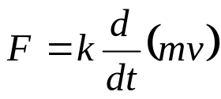
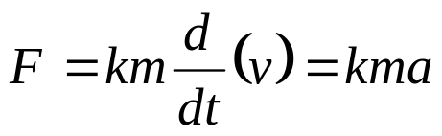

Newton’s Laws of Motion
From the 1st Law
For a particle to accelerated, it must be subjected to an external force.
However, if the body is at rest or is moving in a straight line with constant velocity, the external forces acting, if any, must be balanced.
From the 2nd Law
From 3rd Law
Force is due to interaction between two different bodies.
If mass m = constant,
If k = unity,

Slide 10
Basic Definitions
Basic Definitions:
Space-Is a geometric region in which the physical events of interest in mechanics occur and it is given in terms of three coordinates measured from a reference point or origin.
Length-is used to specify the position of a point in space or size of a body
Time-Interval between two events
Matter-Anything that occupies space
Inertia- A property that cause a body to resist motion
Mass - Measure of inertia
Force-Action of a body upon another body

Slide 11
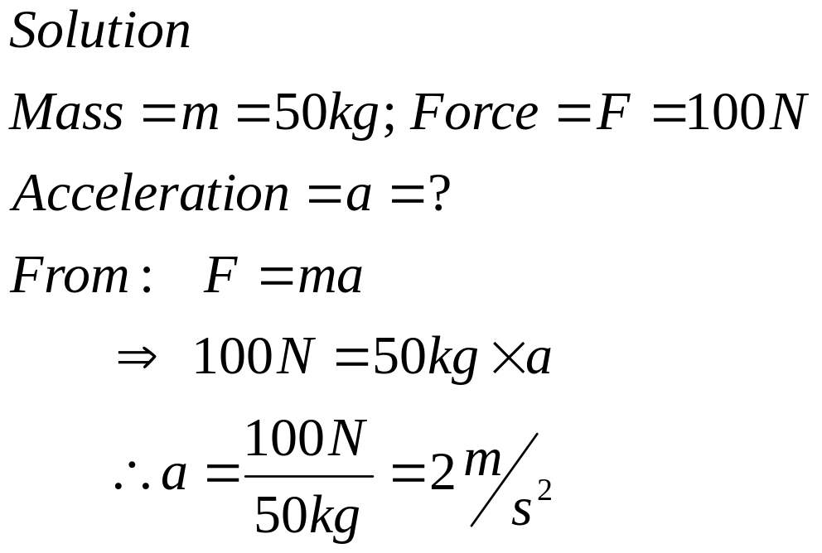
Example 1
A body of mass 50 kg is acted upon by external force whose
magnitude is 100N. What is the acceleration of the body?

Slide 12
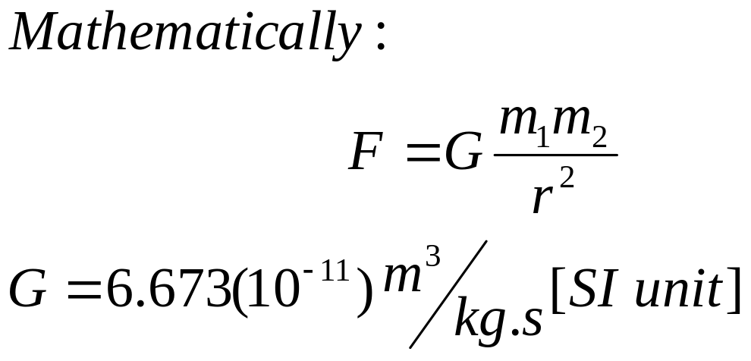
Law of Gravitation
For any two bodies separated by a distance r the force of interaction between them is proportion to the product of their masses and inversely proportion to square of their separation distance
r
m₁
m₂

Slide 13
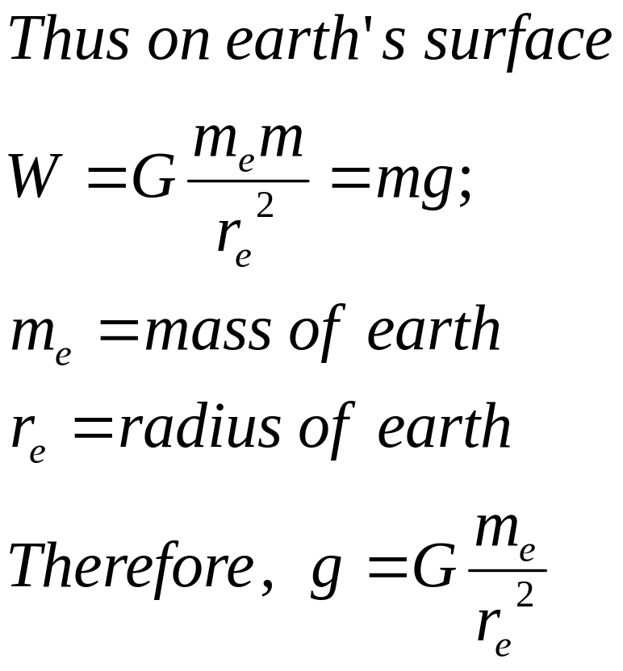
Mass and Weight
Mass (m) of a body is the quantity of matter in the body and it is independent of location.
Weight (W) is the product of mass and gravitational acceleration thus depends on the location

Slide 14
Example 2
Calculate the weight W of a body at the surface of the earth if it has a mass m of 675 kg.
Solution
Mass m = 675 kg; g = 9.81 m/s²
Weight W = mg
= 675 kg x 9.81m/s²
= 6.62 x 10³ N

Slide 15
Basic Units
Quantity | SI Unit | Symbol
Length | meter | m
Mass | kilogram | kg
Time | second | s
Electric Current | Ampere | A
Temperature | Kelvin | K
Amount of Substance | mole | mol
Luminous intensity | candela | cd

Slide 16
Derived Units
Quantity | Derived SI Unit | Symbol | Special Name
Area | square meter | m²
Volume | cubic meter | m³
Linear Velocity | meter per second | m/s
Linear Acceleration | meter per second squared | m/s²
Frequency | (cycle) per second | Hz | Hertz
Density | kilogram per cubic meter | Kg/m³
Force | Kilogram meter per second squared | N | Newton
Pressure /Stress | Newton per meter squared | Pa | Pascal
Work /Energy | Newton.meter | J | Joule
Power | Joule per second | W | Watt
Moment of Force | Newton.meter | N.m

Slide 17
Force Systems and Characteristics of Forces
A force system comprises of several forces acting on a body of group of related bodies
Force system are classified according to the arraignment of constituent forces.
  Collinear: act along the same line
  Parallel /Coplaner : lie in the same plane
  Concurrent: line of action of force interact at a common point

Slide 18
Equilibrium
A body is in equilibrium if
it is at rest relative to an initial reference frame
the body moves with constant velocity along a straight line relative to an initial frame
Effects of a force on a rigid body depend on
The magnitude of the force
The direction of the force, and
The line of action of the force

Slide 19
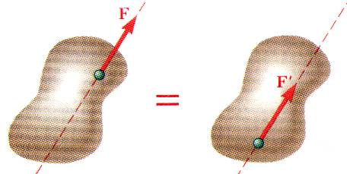
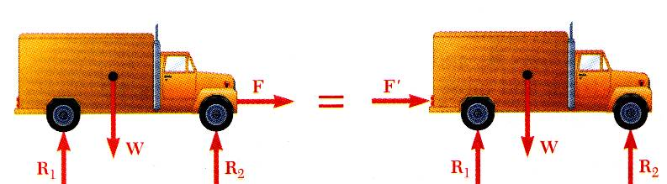
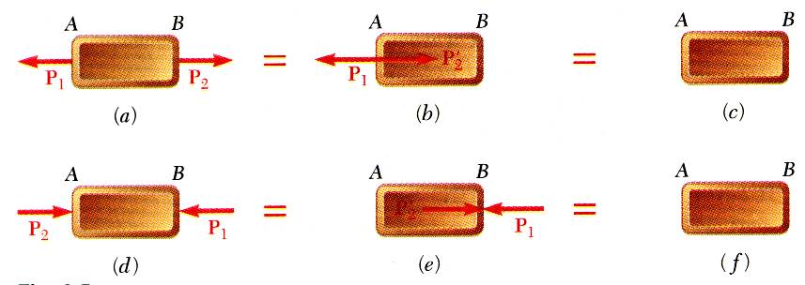
Principle of Transmissibility
Principle of Transmissibility -
The point of application of a force acting on a rigid body may be placed anywhere along its line of action without altering the conditions of equilibrium or motion of the rigid body.
Moving the point of application of the force F to the rear bumper does not affect the motion or the other forces acting on the truck.
Principle of transmissibility may not always apply in determining internal forces and deformations.

Slide 20
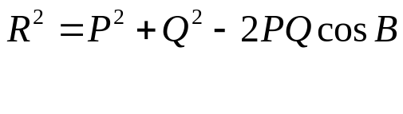
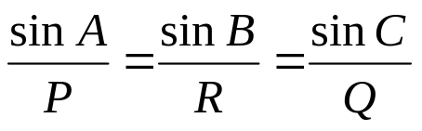



Addition of Vectors
P
Law of cosines
R=Q+P
Q
Q
Law of sines,
P
Trapezoid rule for vector addition
C
B
P
Vector addition is commutative
R=Q+P
Note : P, Q and R are magnitudes of forces and , respectively. A, B and C are interior angles of the force triangle.
Q
A
Triangle rule for vector addition

Slide 21
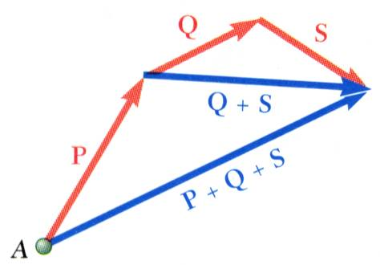
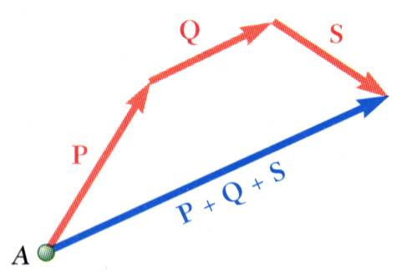
Addition of Vectors
Addition of three or more vectors through repeated application of the triangle rule
The polygon rule for the addition of three or more vectors.
Vector addition is associative,

Slide 22
Review of Geometry
C
From Diagram (a),
D + A = 180º
D + C = 180º
A = C and B = D
From Diagram (b),
G = E and H = F
H =L and E = I
From Diagram (c),
M + N + Q =180
N =180 - P
D
B
(a)
A
H
G
E
F
(b)
L
K
I
J
Q
(c)
N
P
M

Slide 23
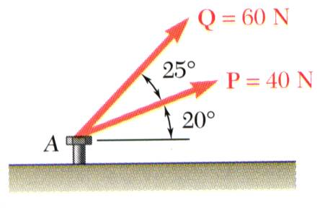
Example 3
Graphical Solution
Graphical solution - A half or full parallelogram with sides equal to P and Q is drawn to scale.
P’
Q’
Q
R
β
The two forces act on a bolt at A. Determine their resultant.
P
The magnitude and direction of the resultant or of the diagonal to the parallelogram are measured,
R = 98 N β = 35º

Slide 24
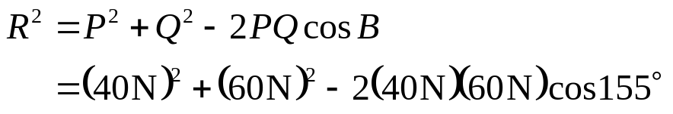
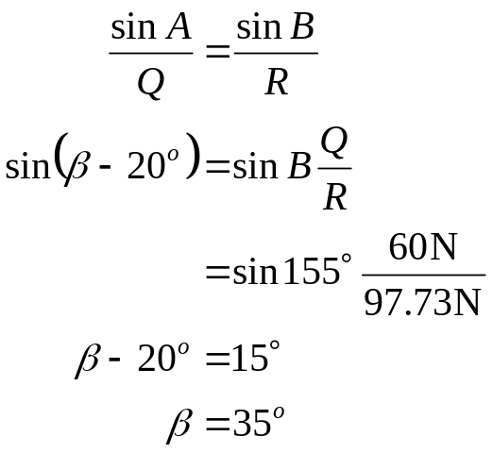
Example 3
Trigonometric solution
From the Law of Cosines,
C
155º
Q=60 N
R = 97.73 N
β-20º
25º
From the Law of Sines,
β
R
B
20º
P =40 N
A

Slide 25


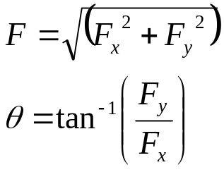
Rectangular Components of Force
A force vector may be resolved into perpendicular components so that the resulting parallelogram is a rectangle. The resulting x and y components are referred to as rectangular vector components and
y
F_{y}
F
Vector components may be expressed as products of the unit vectors with the scalar magnitudes of the vector components.
θ
x
F_{x}
F_{x} and F_{y} are referred to as the scalar components

Slide 26
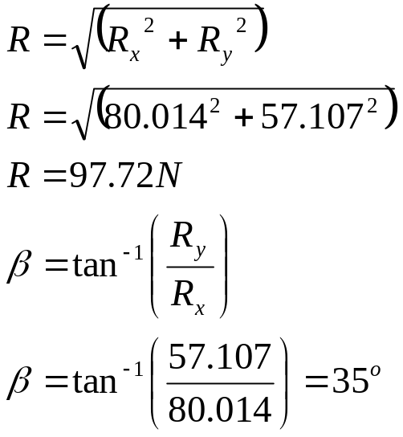
Example 4 (mech 1)
R_{x} =ΣF_{x} =Pcos 20º + Qcos (20º +25^{o)}
= 40cos 20º + 60cos 45º
= 80.014 N
R_{y}=ΣF_{y} =Psin 20º + Qsin (20º +25^{o)}
= 40sin 20º + 60sin 45º
= 57.107 N
Solve Example 3 using Rectangular Components solution
R
Q = 60 N
25º
β
P = 40 N
20º

Slide 27
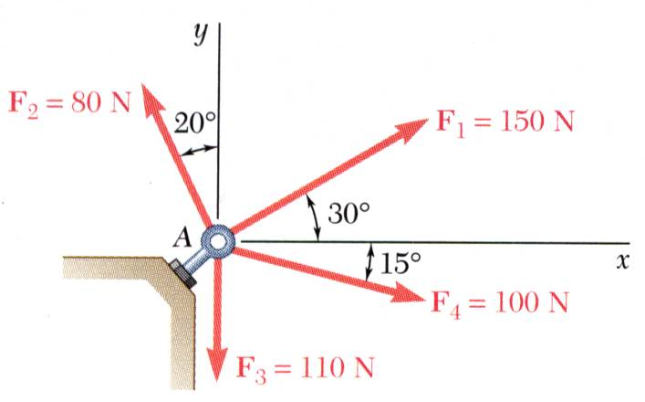
Example 5
SOLUTION:
Resolve each force into rectangular components.
Determine the components of the resultant by adding the corresponding force components.
Calculate the magnitude and direction of the resultant.
Four forces act on bolt A as shown. Determine the resultant of the force on the bolt.

Slide 28
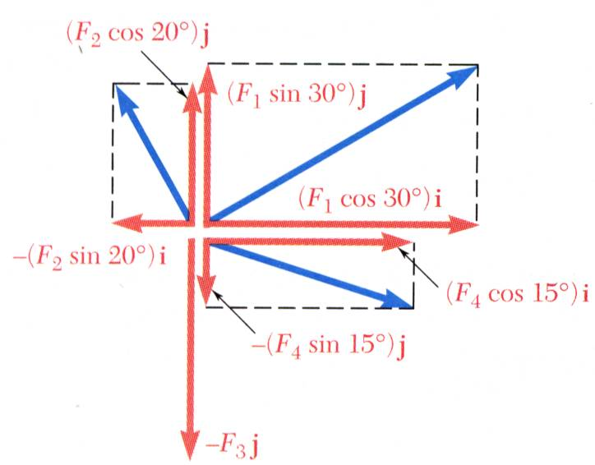
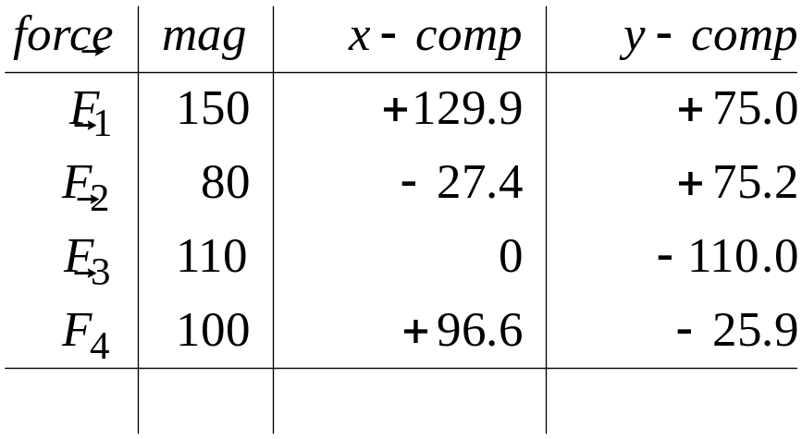


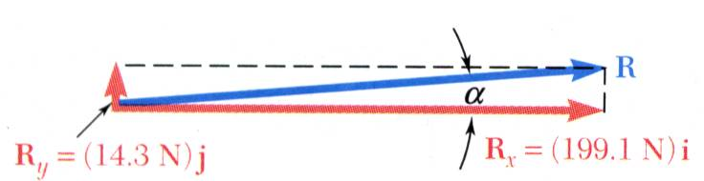


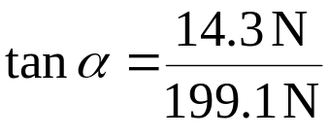

Example 5
SOLUTION:
Resolve each force into rectangular components.
Determine the components of the resultant by adding the corresponding force components.
Calculate the magnitude and direction.

Slide 29
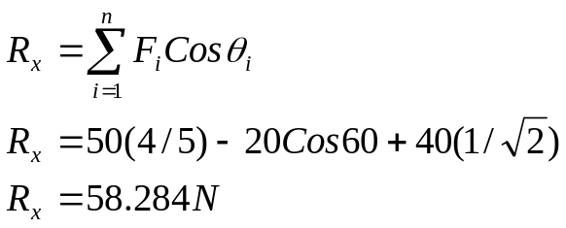
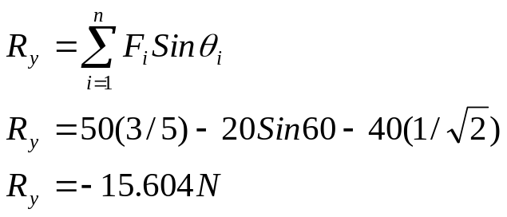
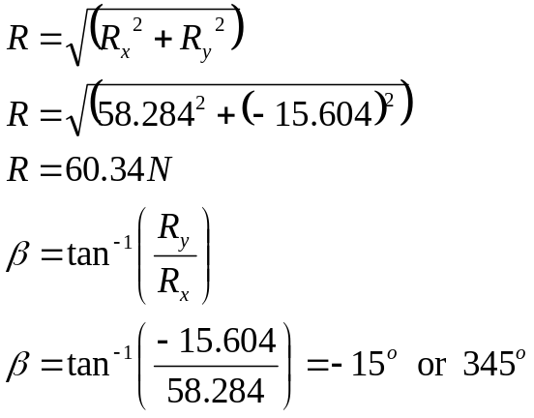
Example 5
Solution
Determine the magnitude of the resultant force and its direction measured from the positive x axis.
y
50 kN
5
3
4
x
60º
√2
1
20 kN
1
40 kN

